Slide 1

Exploring the Universe
Day 2
11/1-11/2

Slide 2
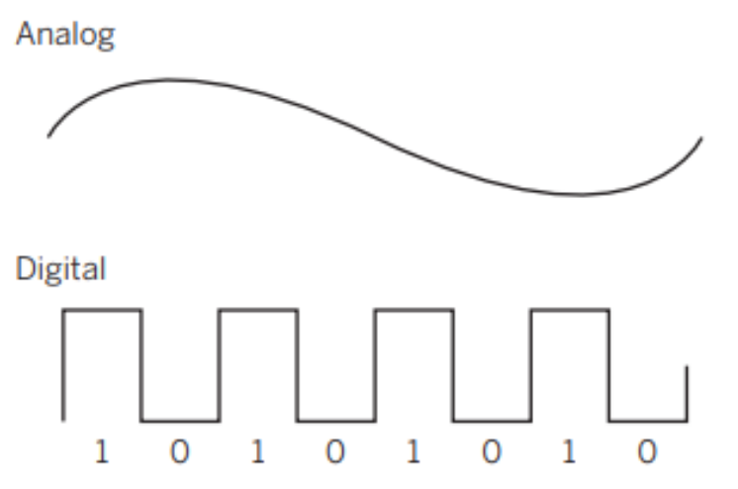
DQ
Analog and digital signals can both be used to transmit information, but in
different ways as seen in the models below.
A scientist in North America has just found the cure for a rare disease and
wants to send a clear message to her colleague in Africa about her discovery.
How should the scientist choose to send the message? Select the explanation
that best describes which method of transmission she should choose.
A. The scientist should transmit the message using analog signals because
they travel more quickly than digital signals.
B. The scientist should transmit the message using digital signals because they
transmit numbers and words.
C. The scientist should transmit the message using digital signals since they
can carry more precise information than analog signals because they have
two precise states—zero and one.
8ESS1.1

Slide 3
Advantages of Digital Signal Over Analog Signal
There are several advantages using digital signal over an analog signal.
Digital signals are more secure, and they do not get damaged by noise.
These signals use low bandwidth
They allow the signals transmitted over a lengthy distance.
Digital signal has a higher rate transmission
By using these signals, we can translate the messages, audio, video into device language.
Digital signals enable the transmission of multidirectional concurrently.
8ESS1.1

Slide 4


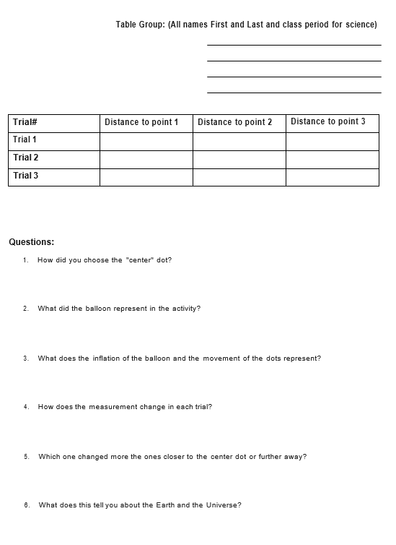
Add this information to the evidence collection summary.
Revise initial model
8ESS1.1

Slide 5


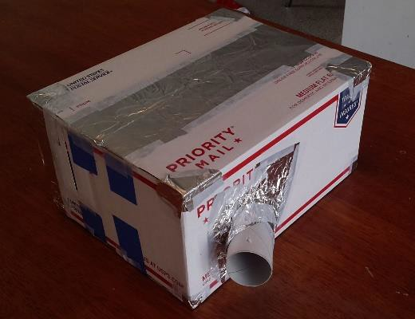
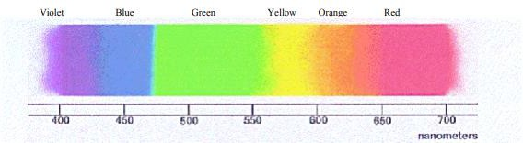
Spectrum Observations
You will be exploring light in much the same way as scientists do. An important part of scientific understanding comes from making and recording careful observations. This will be an important part of your scientific discovery, and information gathered will be used throughout this activity.
Blue light and red light are both just light, or energy, but the blue light has a higher frequency, or shorter wavelength, than the red light.
The wavelengths get successively longer when moving from left to right in the spectroscope. Visible light runs from about 400 to 700 nanometers.
At 600 nanometers, what color would you expect to see? At 450? At 650?
8ESS1.1

Slide 6
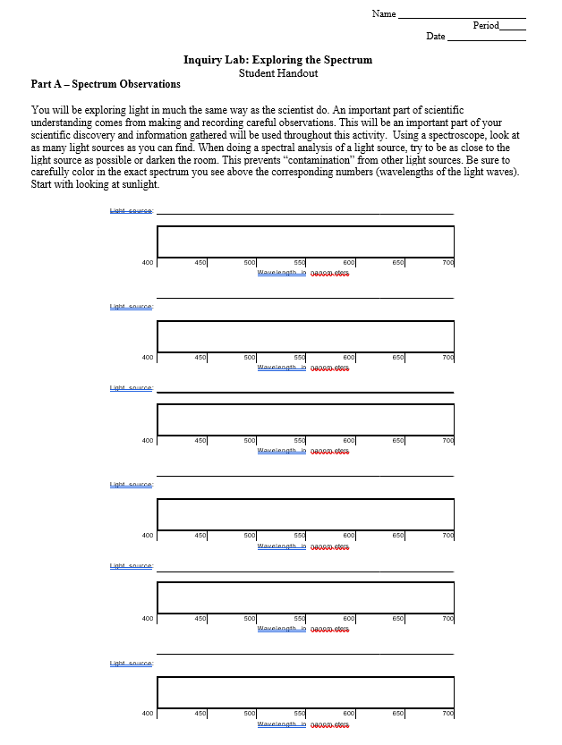
Spectrum Observations
Using a spectroscope, look at as many light sources as you can find. When doing a spectral analysis of a light source, try to be as close to the light source as possible or darken the
room. This prevents “contamination” from other light sources. Using the Light Source Wavelength Data Sheet, be sure to carefully color in the exact spectrum you see above the corresponding numbers (wavelengths of the light waves). Start with looking at sunlight. The other sources of light will be a flashlight, table lamp, candle, black light, and fluorescent light.
8ESS1.1

Slide 7
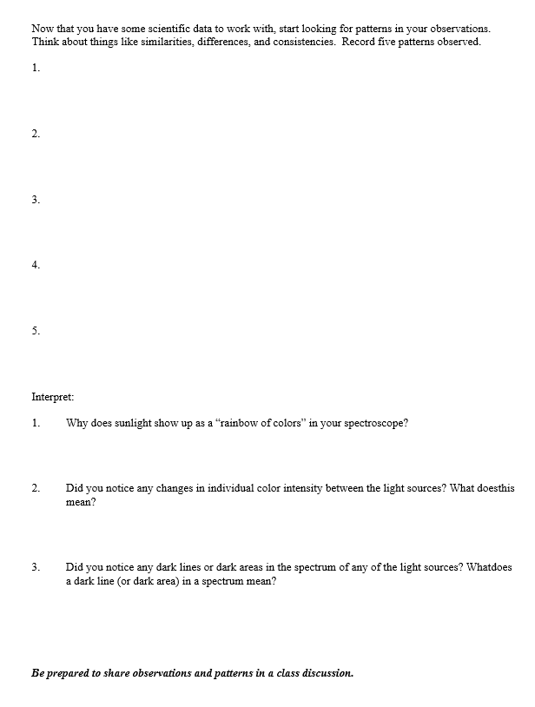
Spectrum Observations
8ESS1.1

Slide 8
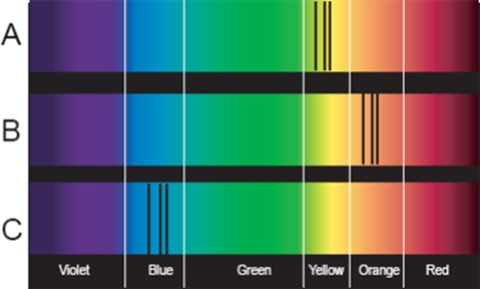
Spectral Line Analysis
Study the following diagram:
Turn in when complete
Spectrums A, B and C are from identical stars within our galaxy. Spectrum A represents a possible spectrum of a star not moving toward or away from Earth. Spectrums B and C show stars in motion with respect to an observer on Earth. Compare the three spectrums and answer the following questions:
1. What is the approximate range in nanometers that the black lines fall in for A? for B? for C?
2. Which spectrum is that of a star moving toward Earth?
3. Which spectrum is that of a star moving away from Earth?
4. In comparison to A, which is moving faster, B or C? Using data, justify your answer.
8ESS1.1

Slide 9
Revise your initial model
Exit Ticket
8ESS1.1

